Slide 1

Topic B RELATIONAL DATA MODEL

Slide 2
RELATIONAL DATA MODEL
CONTENT
The basic concepts of a database
The relational terminologies
The properties of a relation
Entity Relationship Diagram (ERD)
Transform ERD to Database
Normalization

Slide 3
Basic Concepts of Database
What is a database?
A collection of inter-related data
Inter-related data
This means data are linked together by some mechanism
What is a database management system
A collection of programs to manage(update, insert, delete, select), protect and control access to the database

Slide 4
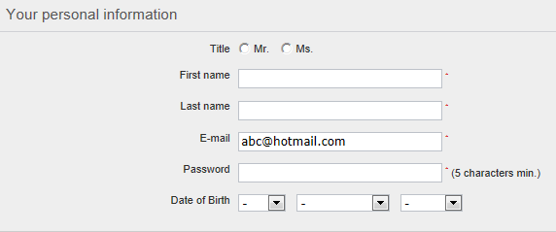
The Relational Terminologies – A relation
Customer
Title | First_name | Last_name | Email | Password | DOB
Ms | Linda | See | LindaS@hotmail.com | Abc123 | NULL
Mr | David | Lee | DavidL@gmail.com | Da12lee | 13/09/1997
Ms | Linda | Soh | LSoh@hotmail.com | Abc123 | 20/12/1998
A relation is a 2 dimensional table. The intersection between a row and column is called a cell.

Slide 5
The Relational Terminologies – Record/Tuple
Title | First_name | Last_name | Email | Password | DOB
Ms | Linda | See | LindaS@hotmail.com | Abc123 | NULL
Mr | David | Lee | DavidL@gmail.com | Da12lee | 13/09/1997
Ms | Linda | Soh | LSoh@hotmail.com | Abc123 | 20/12/1998
Customer
Each row in the table is a record which represents an individual object in the relation.
Record of a table is also called tuple.

Slide 6
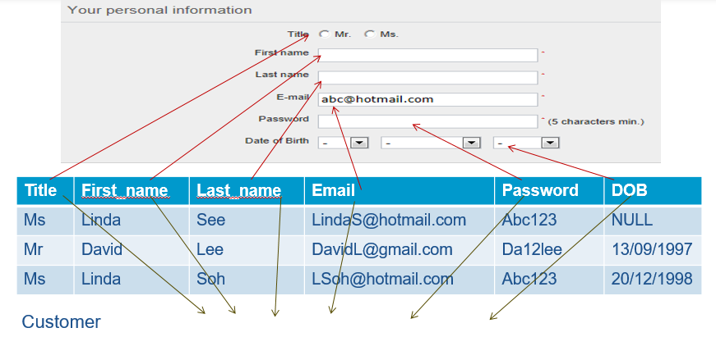
The Relational Terminologies – Attributes
Attributes are column names of a table to define the characteristics of the object.

Slide 7
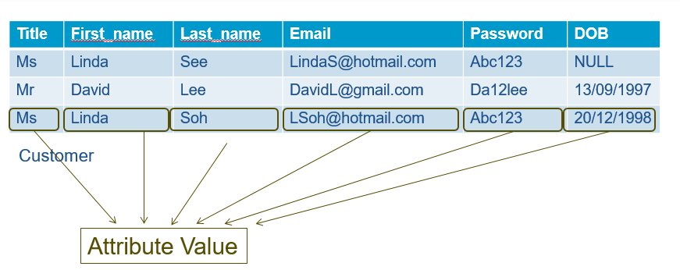
The Relational Terminologies – Attribute Values
Concept of NULL Attribute Value –
NULL is a special value allowed in a relational database
NULL means the value is UNKNOWN or NOT APPLICABLE

Slide 8
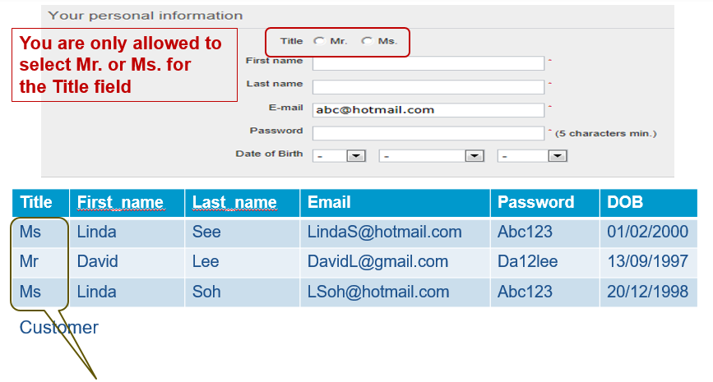
The Relational Terminologies – Attribute Domain
Attribute Domain –
The set of allowable values of that attribute (Example Ms, Mr)
A description of the possible values for that attribute
Physical Description
Semantic Description

Slide 9
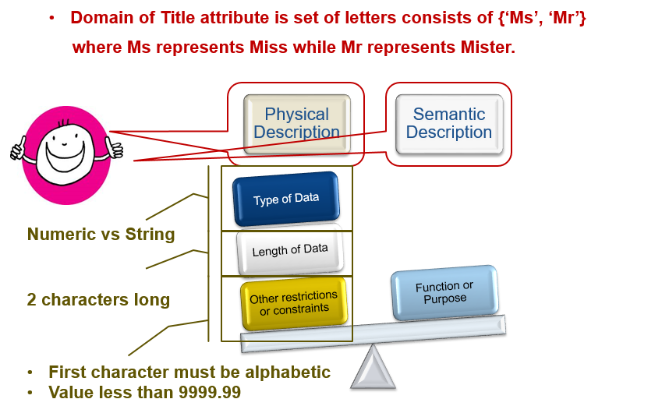
The Relational Terminologies – Attribute Domain

Slide 10
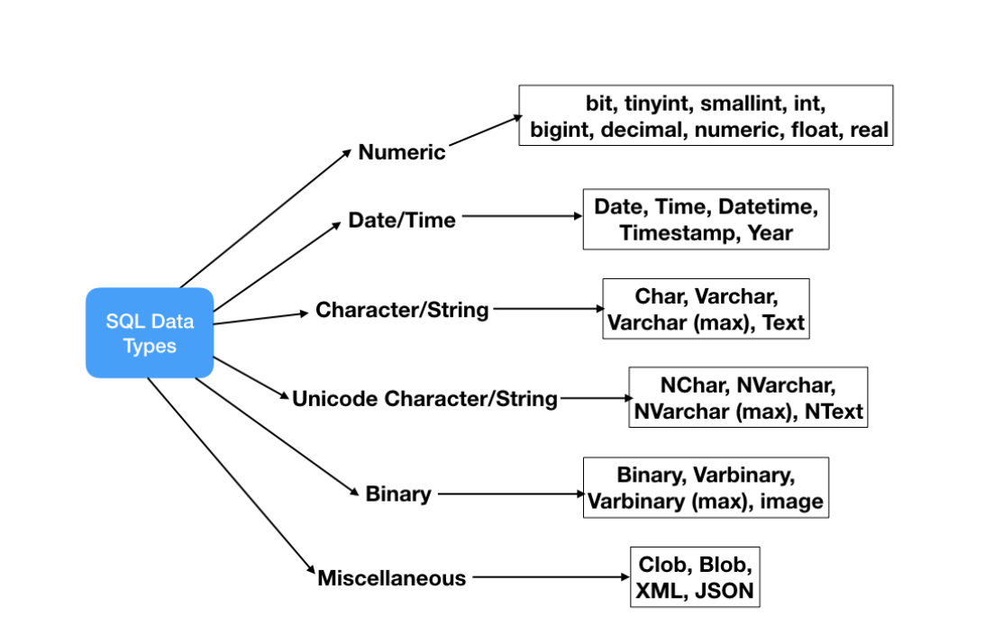
The Relational Terminologies – Attribute DataType / SQL Date Type
What is the difference between Char and Varchar?
Not all data types are supported by every relational database management systems.
Source:https://www.journaldev.com/16774/sql-data-types, 29 Feb 2020
Notes:
Link the topic to the SQL Schema and SQL Type.
Explain the difference between Char and VarChar. Direct them to find out more from the link.

Slide 11

The Relational Terminologies – Relational Database
A collection of inter-related proper form relations
Customer
Cart
Title | First_name | Last_name | Email | Password | DOB
Ms | Linda | See | LindaS@hotmail.com | Abc123 | NULL
Mr | David | Lee | DavidL@gmail.com | Da12lee | 13/09/1997
Ms | Linda | Soh | Lsoh@hotmail.com | Abc123 | 20/12/1998
Email | Product_code | Cart_ID | Qty
DavidL@gmail.com | HG4872 | C10001 | 1
DavidL@gmail.com | HG5879 | C10002 | 1

Slide 12
Properties Of A Relation
A table must satisfy the SIX properties of a relation.
#1: Name of Relation is unique in a database
You cannot create another relation/table in the same database by the same name
#2: Every cell must be single-valued
You cannot have multi-valued cell
#3: Attribute name in a relation must be unique
You cannot have two attributes by the same name
#4: Values of an attribute are from the same domain
#5: Order of tuples or attributes in a relation does not matter
#6: Each tuple in a relation is unique
You cannot have duplicate tuple/row

Slide 13
The Relationship Integrity Rules - Keys
Candidate Key
Primary Key
Foreign Key
An
Attribute
A candidate key is -
A Minimal group of attributes
Which can uniquely IDENTIFY a Tuple in a relation

Slide 14
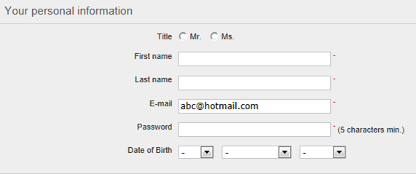
The Relationship Integrity Rules – Candidate Keys
Email (an attribute) can uniquely identify a customer tuple (record) in the Customer relation
Candidate key
Title | First_name | Last_name | Email | Password | DOB
Ms | Linda | See | LindaS@hotmail.com | Abc123 | NULL
Mr | David | Lee | DavidL@gmail.com | Da12lee | 13/09/1997
Ms | Linda | Soh | LSoh@hotmail.com | Abc123 | 20/12/1998
Customer

Slide 15
The Relationship Integrity Rules – Candidate Keys
Title | First_name | Last_name | Email | Password | DOB
Ms | Linda | See | LindaS@hotmail.com | Abc123 | NULL
Mr | David | Lee | DavidL@gmail.com | Da12lee | 13/09/1997
Ms | Linda | Soh | LSoh@hotmail.com | Abc123 | 20/12/1998
Customer
Identify the group of attributes which can uniquely identify a customer based on the
tuples
A minimal group of attributes
First_name, Last_name, Password

Slide 16
The Relationship Integrity Rules – Primary Key
There are TWO candidate keys of customer relation:
Single attribute email
Minimal group of attributes First name, last name, Password
NO! We do not need so many identifiers for a relation.
Choose one of the most suitable candidate key be the official identifier of a relation - Primary key
Do we need so many identifiers
for a relation ?

Slide 17
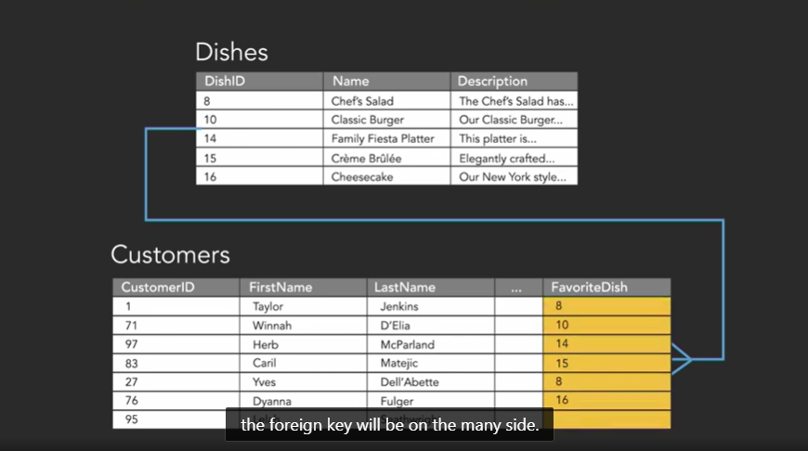
The Relationship Integrity Rules – Foreign Keys
What is the Foreign key?
An attribute (column)
OR a group of attributes (2 or more columns) with a relation that matches
the value of the primary key OR the candidate key
of the home OR other relation
Notes:
Use the example, Dishes -> Customers, to explain also NOT natural key.

Slide 18
The Relationship Integrity Rules – Foreign Keys
Title | First_name | Last_name | Email | Password | DOB
Ms | Linda | See | LindaS@hotmail.com | Abc123 | NULL
Mr | David | Lee | DavidL@gmail.com | Da12lee | 13/09/1997
Ms | Linda | Soh | LSoh@hotmail.com | Abc123 | 20/12/1998
Primary key
Customer
Email of cart relation
is the foreign key referencing the primary key in the customer relation
Foreign key
Email | Product_code | Cart_ID | Qty
DavidL@gmail.com | HG4872 | C1001 | 1
DavidL@gmail.com | HG5879 | C1001 | 1
Cart

Slide 19

The Relationship Integrity Rules – Entity Integrity Rule
Applies to primary key
Title | First_name | Last_name | Email (Primary Key) | Password | DOB
Ms | Linda | See | LindaS@hotmail.com | Abc123 | NULL
Mr | David | Lee | DavidL@gmail.com | Da12lee | 13/09/1997
Ms | Linda | Soh | LSoh@hotmail.com | Abc123 | 20/12/1998
Mr | Jonanthan | Sim | NULL | JonS098 | NULL
Email is the attribute of the Primary key, CANNOT BE NULL
Primary key = attribute or combination of attributes cannot be NULL

Slide 20
The Relationship Integrity Rules – Entity Integrity Rule
Composite Primary Key = Email + Product_code + Cart_ID
Email (PK) | Product_code (PK) | Cart_ID (PK) | Qty
DavidL@gmail.com | HG4872 | C1001 | 1
DavidL@gmail.com | HG4872 | C1001 | 1
NULL | HG4872 | C1002 | 2
No part of a primary key can be duplicated
No part of the primary key can be Null

Slide 21
The Relationship Integrity Rules – Referential Integrity Rule
Applies to foreign key
Title | First_name | Last_name | Email (Primary Key) | Password | DOB
Ms | Linda | See | LindaS@hotmail.com | Abc123 | NULL
Mr | David | Lee | DavidL@gmail.com | Da12lee | 13/09/1997
Ms | Linda | Soh | LSoh@hotmail.com | Abc123 | 20/12/1998
Davidl@gmail.com of cart relation is the foreign key referencing the primary key in the customer relation
Customer
Email (Foreign Key) | Product_code | Cart_ID | Qty
DavidL@gmail.com | HG4872 | C1001 | 1
DavidL@gmail.com | HG5879 | C1001 | 1
JuneL@gmail.com | HG4872 | C1002 | 2
Cart

Slide 22
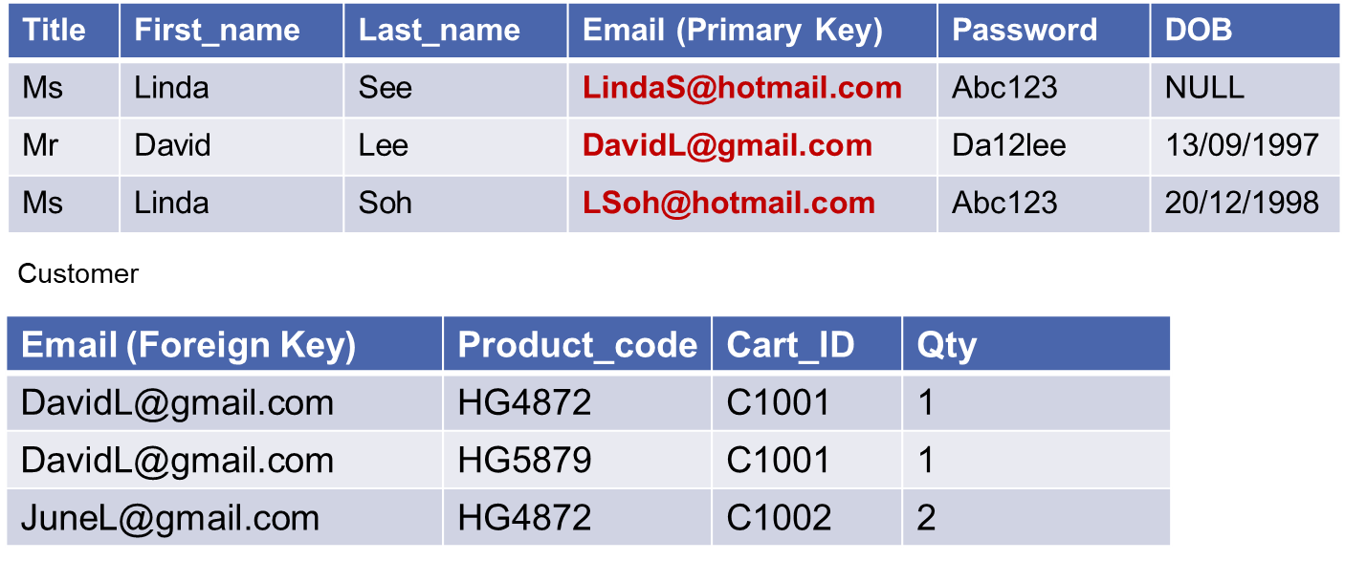
The Relationship Integrity Rules – Referential Integrity Rule
> Junel@gmail.com of cart relation is not found in the customer relation
> Can we set the email in 3rd row of cart relation to Null? Is this logical?
Cart
Yes we can set part or whole of the foreign key to Null

Slide 23
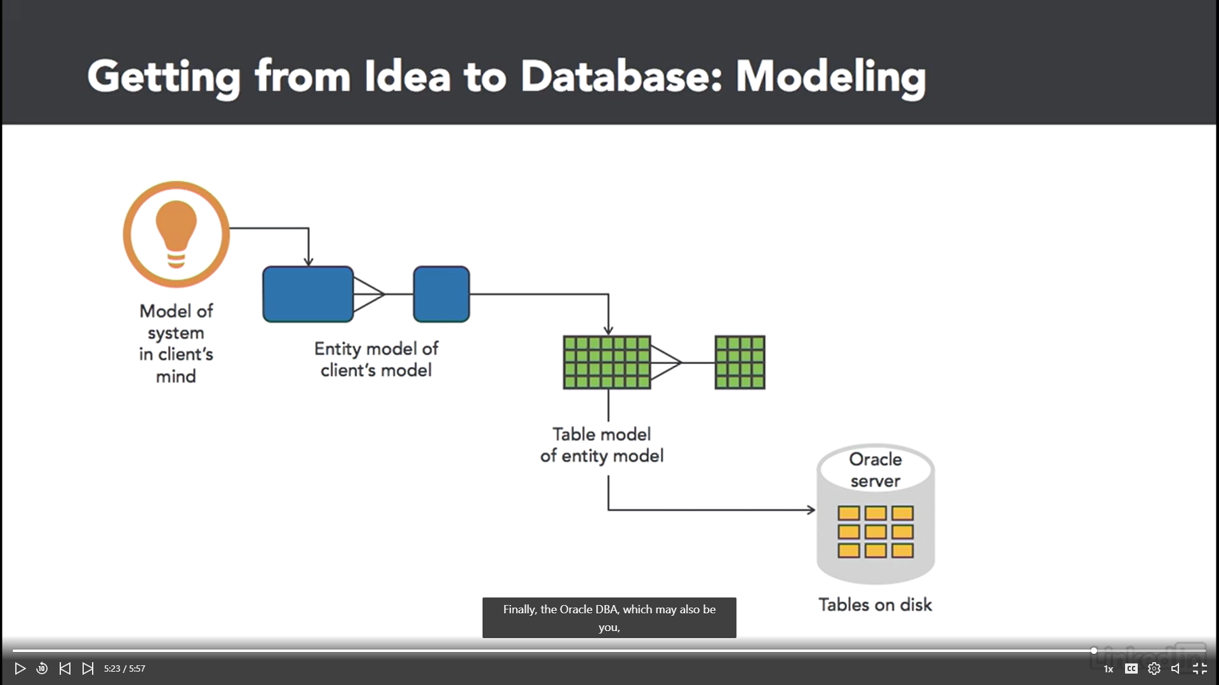

Slide 24
Entity Relationship Diagram - Conceptual Data Model
A set of concepts that describe the structure of a database and the associated retrieval and update transactions.
Independent of the particular type of DBMS software, such as Oracle, Microsoft SQL and hardware.
Conceptual Data Model
Pictorial description of the structure of a database
Drawn using Entity Relationship diagram (ERD)

Slide 25
Entity Relationship Diagram -Conceptual Data Model (ERD)

Slide 26
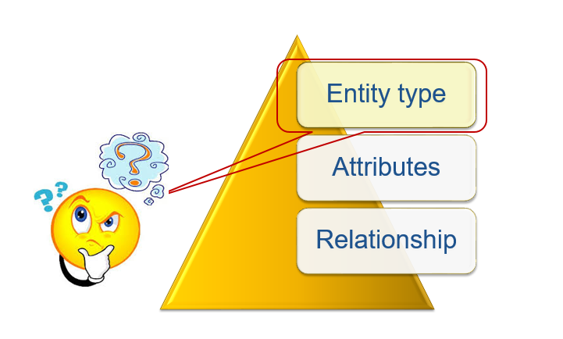
Entity Relationship Diagram – Entity Type
Defined as a collection of entities
that has common properties and
and are of interest to an organization
Examples:
Customer, Address and Cart
Product, Clothes and Bag

Slide 27
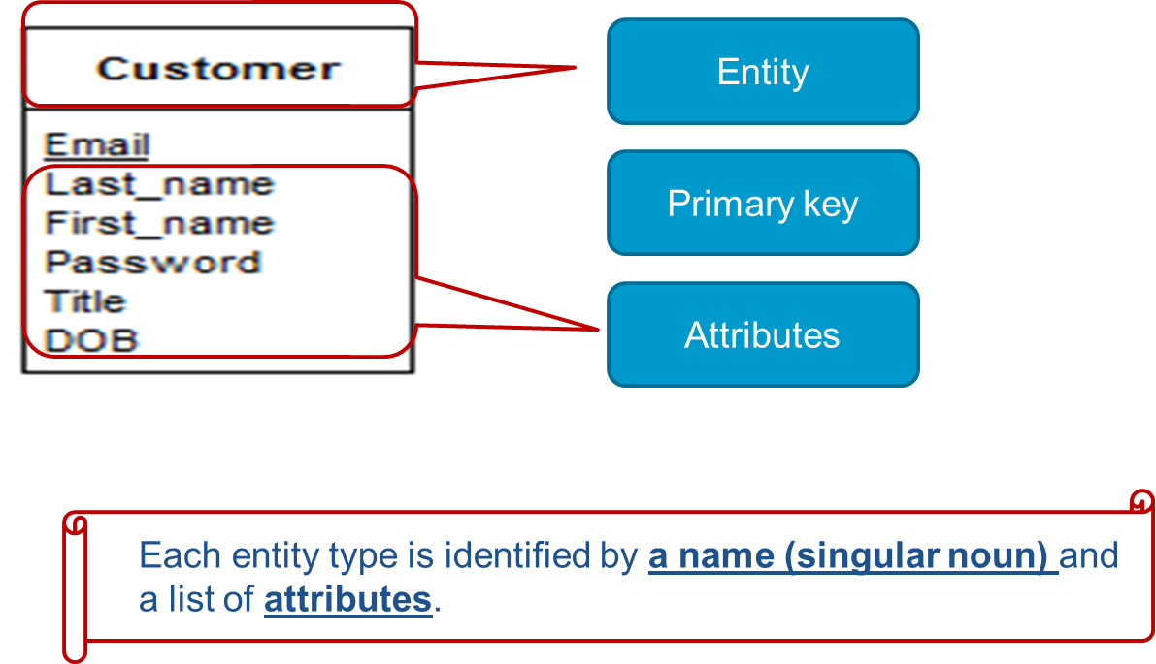
Entity Relationship Diagram - Entity Type

Slide 28
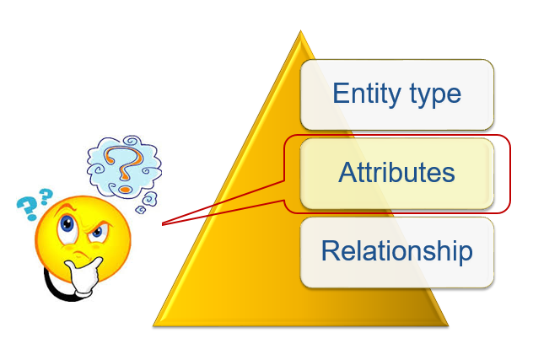
Entity Relationship Diagram - Attributes
Composite Attribute – an attribute composes of multiple components. E.g. Name and Address
Simple Attribute – an attribute that composes of single component. E.g. Gender, mobile_no, student_no
Derived Attribute – an attribute that derives from a set of attributes. E.g. Age

Slide 29
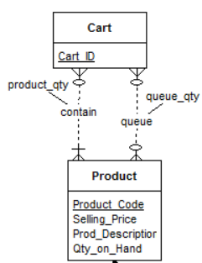
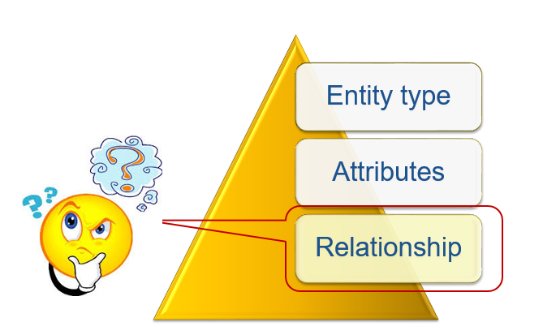
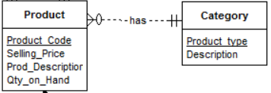
Entity Relationship Diagram – Relationships (single and multiple)
Relationship is the association between 2 entities.
Each relationship has a verb-based name.
E.g. The ‘has’ relationship between product and product_type enables the user to know that this product is a blouse
Multiple relationships can be created when the two entities are associated through two distinct relationships.
(a) The cart must contain one or many products
(b) The cart may be queuing for one or more products that are out-of-stock.

Slide 30
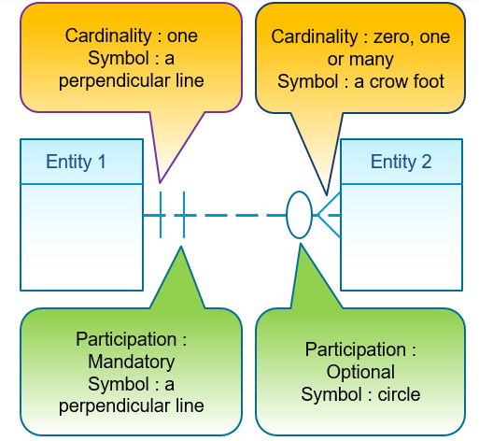
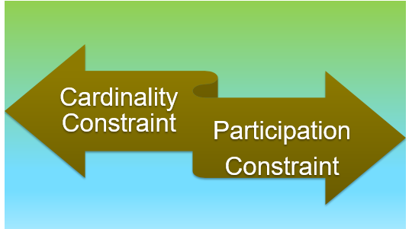
Entity Relationship Diagram – Structural Constraints
Reflect business rules set by the organization

Slide 31
Entity Relationship Diagram – Cardinality Constraints
Describe the number of entity instances that participate in a relationship
Cardinality Ratios | Read as
1 : 1 | One-to-one
1 : M | One-to-many
M : N | Many-to-many

Slide 32
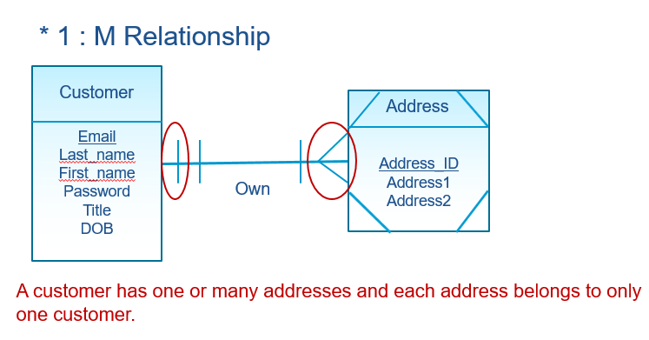
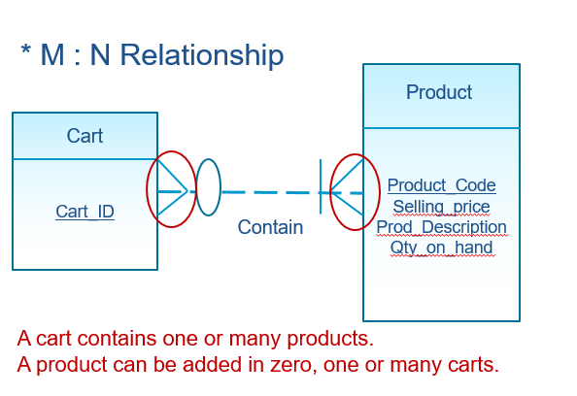
Entity Relationship Diagram – Cardinality Constraints

Slide 33
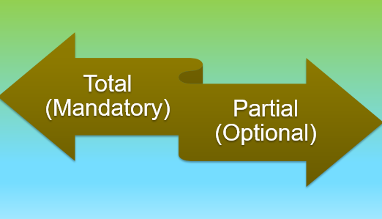
Entity Relationship Diagram – Participation Constraints
Determines if the existence of an entity type depends on another entity type

Slide 34
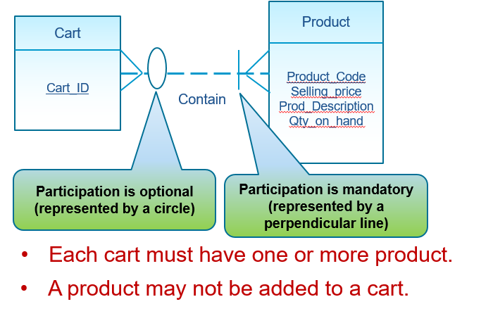
Entity Relationship Diagram – Participation Constraints

Slide 35
How to transform an Entity Relation Diagram to Database?
Database tables does not have M:N Relation?
How to systematically transform an ERD to Database?
Notes:
Teaching Note: Important discussion, teach the techniques on how to transform an ERD to Database.
1. Convert M:N into 2 1:M relaRelation is represented using Foreign Key.

Slide 36
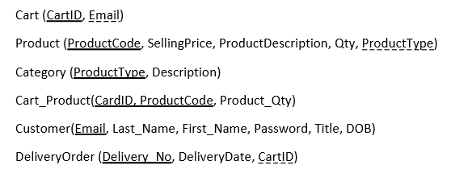
How to transform an Entity Relation Diagram to Database?
Database tables does not have M:N Relation?
How to systematically transform an ERD to Database?
Notes:
Teaching Note: Important discussion, teach the techniques on how to transform an ERD to Database.
1. Convert M:N into 2 1:M relaRelation is represented using Foreign Key.

Slide 37
Entity Relationship Diagram and Database
Definition |  | Example
ERD | Database | ERD | Database
Entity type | Relation / Table | Customer Entity type | Customer Relation / Table
Entity | Tuple / Row | Customer Entity | Customer Tuple / Row
Attribute | Attribute / Column | Email Attribute | Email Attribute / Column
Relationship | Foreign key referencing Primary key | Relationship Own | Email_addr (Foreign key) referencing Email (Primary key)
Primary key | Primary key | Primary key (Email) | Primary key (Email)

Slide 38
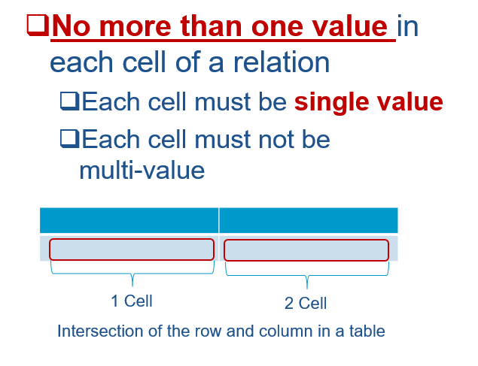
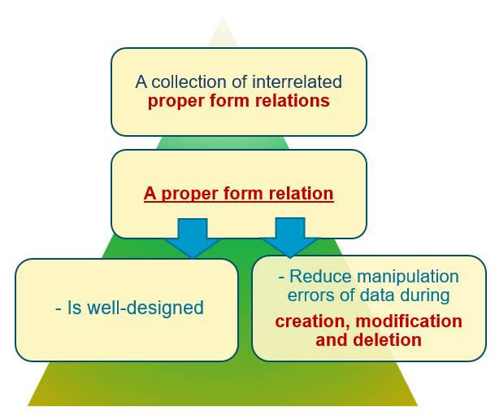
Normalization –Proper Form Relation

Slide 39
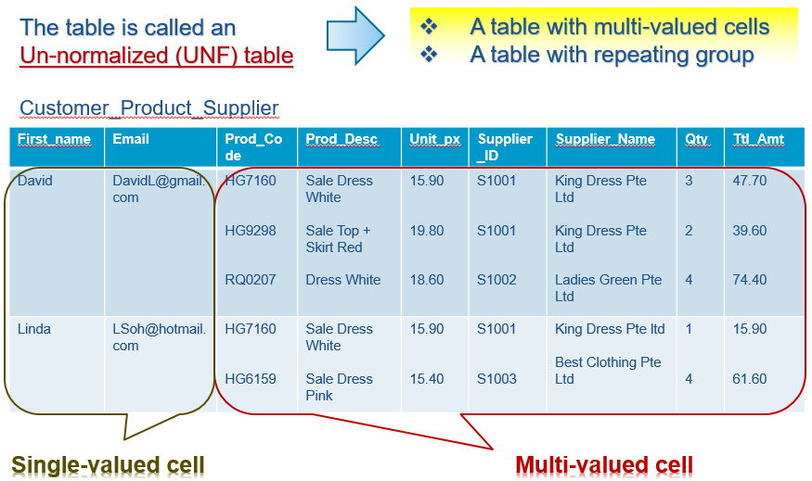
Normalization – Un-normalized Form (0NF/UNF)

Slide 40
Normalization – How To Represent a 0NF/UNF?
First_name | Email | Prod_Code | Prod_Desc | Unit_px | Supplier_ID | Supplier_Name | Qty | Ttl_Amt
David | DavidL@gmail.com | HG7160 HG9298 RQ0207 | Sale Dress White Sale Top + Skirt Red Dress White | 15.90 19.80 18.60 | S1001 S1001 S1002 | King Dress Pte Ltd King Dress Pte Ltd Ladies Green Pte Ltd | 3 2 4 | 47.70 39.60 74.40
Linda | LSoh@hotmail.com | HG7160 HG6159 | Sale Dress White Sale Dress Pink | 15.90 15.40 | S1001 S1003 | King Dress Pte Ltd Best Clothing Pte Ltd | 1 4 | 15.90 61.60
Relational Heading Format | Syntax
Customer_Product_Supplier (First_name, Email, { Prod_Code, Prod_Desc, Unit_px, Supplier_ID, Supplier_Name, Qty, Ttl_Amt } ) | <Relation> ( Single-valued columns,.. { Muti-valued columns } )
Notes:
Note: Highlight the terminology “Relational Heading Format”

Slide 41
Normalization – Transform 0NF to 1NF
Normal Form | Description | Problem | Solution
UNF/0NF | Table with multi-valued cells | Violate the properties of relation | Form new row for each multi-valued cell to remove repeating group.
We therefore cannot make use of this improper form relation. We need to transform it to first normal form.

Slide 42

First Normal Form (1NF)
Customer_Product_Supplier
First_name | Email | Prod_Code | Prod_Desc | Unit_px | Supplier_ID | Supplier_Name | Qty | Ttl_Amt
David | DavidL@gmail.com | HG7160 HG9298 RQ0207 | Sale Dress White Sale Top + Skirt Red Dress White | 15.90 19.80 18.60 | S1001 S1001 S1002 | King Dress Pte Ltd King Dress Pte Ltd Ladies Green Pte Ltd | 3 2 4 | 47.70 39.60 74.40
Linda | LSoh@hotmail.com | HG7160 HG6159 | Sale Dress White Sale Dress Pink | 15.90 15.40 | S1001 S1003 | King Dress Pte Ltd Best Clothing Pte Ltd | 1 4 | 15.90 61.60
David
DavidL@gmail.
com
David
DavidL@gmail.
com
Linda
LSoh@hotmail.
com
Step | Description
1 | Forming new row so that each cell only has a single value
2 | Fill in the empty cell
3 | Determine the primary key to uniquely identify each row

Slide 43
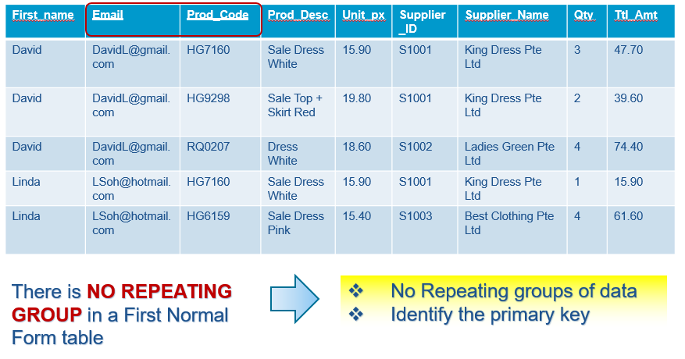
Normalization – First Normal Form (1NF)

Slide 44
Normalization - Anomalies
What are anomalies?
Update
anomaly
Insert
anomaly
Irregularities
Something showing irregularity
Delete
anomaly

Slide 45
Normalization-1NF : Insert anomaly
Customer_Product_Supplier
Primary Key
First_name | Email | Prod_Code | Prod_Desc | Unit_px | Supplier_ID | Supplier_Name | Qty | Ttl_Amt
David | DavidL@gmail.com | HG7160 | Sale Dress White | 15.90 | S1001 | King Dress Pte Ltd | 3 | 47.70
David | DavidL@gmail.com | HG9298 | Sale Top + Skirt Red | 19.80 | S1001 | King Dress Pte Ltd | 2 | 39.60
David | DavidL@gmail.com | RQ0207 | Dress White | 18.60 | S1002 | Ladies Green Pte Ltd | 4 | 74.40
Linda | LSoh@hotmail.com | HG7160 | Sale Dress White | 15.90 | S1001 | King Dress Pte Ltd | 1 | 15.90
Linda | LSoh@hotmail.com | HG6159 | Sale Dress Pink | 15.40 | S1003 | Best Clothing Pte Ltd | 4 | 61.60
First_name | Email | Prod_Code | Prod_Desc | Unit_px | Supplier_ID | Supplier_Name | Qty | Ttl_Amt
Rachel | Rachel@gmail.com | ? | ? | ? | ? | ? | ? | ?
Cannot insert a row when a particular customer (email) does not buy any product

Slide 46
Normalization-1NF : Insert anomaly
Customer_Product_Supplier
Primary Key
First_name | Email | Prod_Code | Prod_Desc | Unit_px | Supplier_ID | Supplier_Name | Qty | Ttl_Amt
David | DavidL@gmail.com | HG7160 | Sale Dress White | 15.90 | S1001 | King Dress Pte Ltd | 3 | 47.70
David | DavidL@gmail.com | HG9298 | Sale Top + Skirt Red | 19.80 | S1001 | King Dress Pte Ltd | 2 | 39.60
David | DavidL@gmail.com | RQ0207 | Dress White | 18.60 | S1002 | Ladies Green Pte Ltd | 4 | 74.40
Linda | LSoh@hotmail.com | HG7160 | Sale Dress White | 15.90 | S1001 | King Dress Pte Ltd | 1 | 15.90
Linda | LSoh@hotmail.com | HG6159 | Sale Dress Pink | 15.40 | S1003 | Best Clothing Pte Ltd | 4 | 61.60
First_name | Email | Prod_Code | Prod_Desc | Unit_px | Supplier_ID | Supplier_Name | Qty | Ttl_Amt
? | ? | HX1021 | Red Dress | 10.10 | ST1001 | King Dress Pte ltd | ? | ?
Cannot insert a row when the new product does not have any new customer

Slide 47
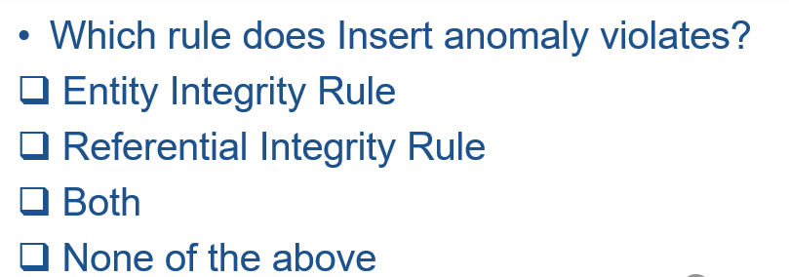
Normalization – 1NF : Insert anomaly

Slide 48
Normalization -1NF: Update anomaly
Customer_Product_Supplier
First_name | Email | Prod_Code | Prod_Desc | Unit_px | Supplier_ID | Supplier_Name | Qty | Ttl_Amt
David | DavidL@gmail.com | HG7160 | Sale Dress White | 15.90 | S1001 | King Dress Pte Ltd | 3 | 47.70
David | DavidL@gmail.com | HG9298 | Sale Top + Skirt Red | 19.80 | S1001 | King Dress Pte Ltd | 2 | 39.60
David | DavidL@gmail.com | RQ0207 | Dress White | 18.60 | S1002 | Ladies Green Pte Ltd | 4 | 74.40
Linda | LSoh@hotmail.com | HG7160 | Sale Dress White | 15.90 | S1001 | King Dress Pte Ltd | 1 | 15.90
Linda | LSoh@hotmail.com | HG6159 | Sale Dress Pink | 15.40 | S1003 | Best Clothing Pte Ltd | 4 | 61.60
Dress Pure
White
King Kong Dress
Pte Ltd
King Kong Dress
Pte Ltd
Dress Pure
White
King Kong Dress
Pte Ltd
a. Change the supplier name from King Dress Pte Ltd to King Kong Dress Pte Ltd
b. Change the product description of HG7160 to Dress Pure White
Change of supplier name and product description requires updates in several rows

Slide 49
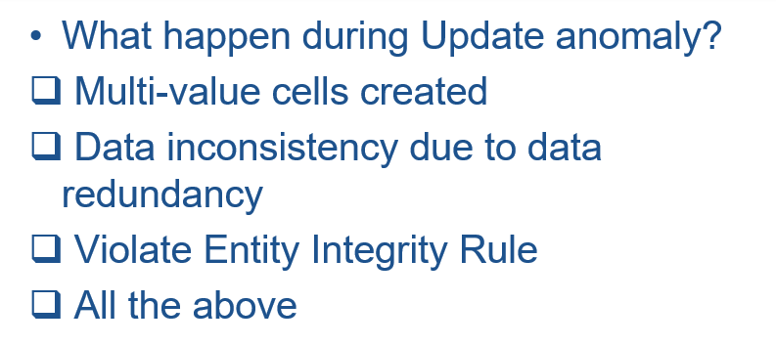
Normalization – 1NF : Update anomaly

Slide 50
Normalization - 1NF : Delete anomaly
Customer_Product_Supplier
First_name | Email | Prod_Code | Prod_Desc | Unit_px | Supplier_ID | Supplier_Name | Qty | Ttl_Amt
David | DavidL@gmail.com | HG7160 | Sale Dress White | 15.90 | S1001 | King Dress Pte Ltd | 3 | 47.70
David | DavidL@gmail.com | HG9298 | Sale Top + Skirt Red | 19.80 | S1001 | King Dress Pte Ltd | 2 | 39.60
David | DavidL@gmail.com | RQ0207 | Dress White | 18.60 | S1002 | Ladies Green Pte Ltd | 4 | 74.40
Linda | LSoh@hotmail.com | HG7160 | Sale Dress White | 15.90 | S1001 | King Dress Pte Ltd | 1 | 15.90
Linda | LSoh@hotmail.com | HG6159 | Sale Dress Pink | 15.40 | S1003 | Best Clothing Pte Ltd | 4 | 61.60
Delete Linda will result in removing product such as HG6159 that is only bought by Linda
Loss of information when rows are deleted from the relation

Slide 51
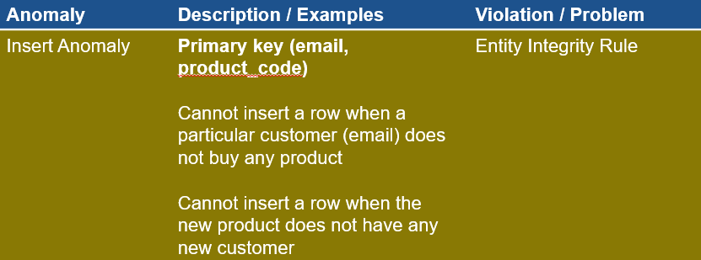
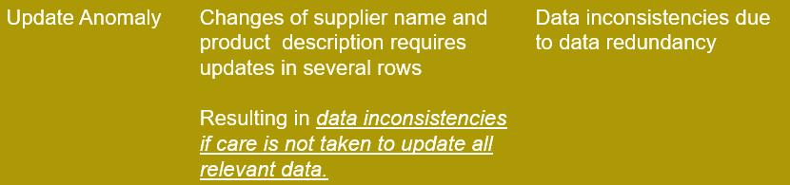

Normalization – Anomaly Summary

Slide 52
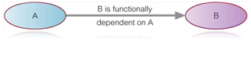
Normalization – Functional Dependency
A functional dependency is a constraint about two or more columns of a table
Occurs when the value of an attribute is fully
dependent upon another attribute’s value
A relation is said to be in Second Normal Form if all non-key attributes are fully dependent on whole of its primary key
Attribute on the left hand side of a functional dependency (FD) is known as LHS or determinant.
Attribute B’s value is functionally dependent upon attribute A’s value. i.e. if there exists at most one value of B for every value of A.

Slide 53
Normalization – Functional Dependency
Examples of functional dependency
Supplier_ID -> Supplier_Name
Supplier_ID -> Supplier_Phone
Supplier_ID -> Supplier_Address
Supplier_ID -> Supplier_Name, Supplier_Phone, Supplier_Address

Slide 54
Normalization – Transform 1NF to 2NF
Normal Form | Description | Problem | Solution
1NF | Table with anomalies | Violate the properties of relation | Transform further to second normal form.
As there are anomalies in 1NF , we therefore need to transform it second normal form.

Slide 55
Normalization – Second Normal Form (2NF)
Customer_Product_Supplier
First_name | Email | Prod_Code | Prod_Desc | Unit_px | Supplier_ID | Supplier_Name | Qty | Ttl_Amt
David | DavidL@gmail.com | HG7160 | Sale Dress White | 15.90 | S1001 | King Dress Pte Ltd | 3 | 47.70
David | DavidL@gmail.com | HG9298 | Sale Top + Skirt Red | 19.80 | S1001 | King Dress Pte Ltd | 2 | 39.60
Partial keys | Whole key
Email
Email, Prod_Code
Prod_Code
Step1 – Identify keys

Slide 56
Normalization – Second Normal Form
Customer_Product_Supplier
First_name | Email | Prod_Code | Prod_Desc | Unit_px | Supplier_ID | Supplier_Name | Qty | Ttl_Amt
David | DavidL@gmail.com | HG7160 | Sale Dress White | 15.90 | S1001 | King Dress Pte Ltd | 3 | 47.70
David | DavidL@gmail.com | HG9298 | Sale Top + Skirt Red | 19.80 | S1001 | King Dress Pte Ltd | 2 | 39.60
Partial Functional Dependencies (One or more non-key attributes functionally dependent on part (but not all) of the primary key) | Functional Dependencies with Whole key (Non-key attributes functionally dependent upon whole of primary key)
Email -> First_Name
Email, Prod_Code -> Qty, Ttl_Amt
Prod_Code -> Prod_Desc, Unit_Px,
Supplier_ID, Supplier_Name
Always identify the FD with all the partial keys first, follow by whole key
Step 2 – List functional dependencies with keys

Slide 57
Normalization – Second Normal Form
Functional Dependencies | Relations (Relational Header Format)
Email -> First_Name
Customer (Email, First_Name)
Prod_Code -> Prod_Desc, Unit_Px,
Supplier_ID, Supplier_Name
Product (Prod_Code, Prod_Desc,
Unit_Px, Supplier_ID, Supplier_Name)
Email, Prod_Code -> Qty, Ttl_Amt
Customer_Product_Supplier (Email,
Prod_Code, Qty, Ttl_Amt
For each of the partial dependencies identified, create a relation and name them appropriately. Check there are no anomalies in each of the relations.
Step 2 – Derive relations from functional dependencies

Slide 58
Normalization – Transitive Dependency
Transitive Dependency is a functional dependency between two (or more) non-key attributes in a relation
A relation is said to be in Third Normal Form if there is no functional dependencies among non-key attributes

Slide 59
Normalization - Transform 2NF to 3NF
Relations (Relational Header Format) | 3NF? | Transformation
Customer (Email, First_Name)
Product (Prod_Code, Prod_Desc, Unit_Px, Supplier_ID, Supplier_Name)
Customer_Product_Supplier (Email, Prod_Code, Qty, Ttl_Amt
Yes
Supplier (Supplier_ID,
Supplier_Name)
No
NB: Supplier_ID becomes foreign key ref Supplier
Product (Prod_Code, Prod_Desc, Unix_Px, Supplier_ID)
Yes

Slide 60
Normalization – From 0NF To 3NF
Customer (Email, First_Name)
Supplier (Supplier_ID, Supplier_Name)
Product (Prod_Code, Prod_Desc, Unix_Px, Supplier_ID)
Customer_Product_Supplier (Email, Prod_Code, Qty, Ttl_Amt)
We started with one table and after the 3rd normalization, we have four tables.

Slide 61
Normalization – Summary
Normal Form | Definition | Problem | Solution
UNF/0NF | A table with multi-valued cells or repeating groups | Violate the properties of relation | Form new row for each multi-valued cell to remove repeating group.
1NF | A table without any repeating groups of data | Contain 3 types of anomalies: Insert anomaly Update anomaly Delete anomaly | Remove partial dependencies. Determination of primary key
2NF | A relation that is in the 1NF, and, every non-key attribute is functionally dependent on the whole of its primary key | Functional dependency among the non-key attributes | Create new relation(s). The primary key of the new relation will be served as the foreign key in the existing relation.
3NF | A relation that is in 2NF, and, there is no functional dependency among non-key attributes

Slide 62
Normalization – Relationships Between Normal Forms
Normalisation process splits the information across several relations
Aims to establish relations that are more efficient when we perform insert, update and delete records operations on the relation
A process of grouping attributes into well-structured relations that allow users to insert, delete and modify rows in these relations without errors or inconsistencies resulting from these operations.

Slide 63
THE END

Slide 64
Optional Discussion

Slide 65
Entity Relationship Diagram – Weak Entity and Identification Dependency
Weak entity or Child entity
Address_ID
Address1
Address2
Address
Dependent on parent/owner entity for existence
Cannot be identified using its own attributes only

Slide 66
Entity Relationship Diagram – Weak Entity and Identification Dependency
Email
Last_name
First_name
Password
Title
DOB
Customer
Address_ID
Address1
Address2
Address
Own
Solid line for identifying relationship
Weak entity is represented by a diagonal line in the corners of the rectangle
Identifying owner
The Address entity is dependent on customer entity for existence.
Address_ID needs to combine with Email to form the full-identifier.
Address_ID + Email = Primary Key.

Slide 67
Entity Relationship Diagram - Generalization Hierarchy
Supertype
(General entity type)
Supertype
General hierarchy symbol (A line connecting the subtypes, an arrow connecting the supertype)
Subtype1
Subtype2
Subtype
(Specialised entity type)
Also known as IS-A relationship.
Collection of entity types arrange in hierarchy structure.

Slide 68
Entity Relationship Diagram - Generalization Hierarchy
Common attributes
(Product_code, Selling_price, Prod_Description, Qty_on_hand)
Product
Product_code
Selling_px
Prod_Description
Qty_on_hand
Subtype-specific attributes
(Material, Thickness)
Clothes
Fabric
Bag
Material
Thickness
Subtype-specific attributes
(Fabric)
Attributes that are common to all entities are associated with the Supertype.
Attributes that are unique to a particular subtype are associated with that subtype.

Slide 69
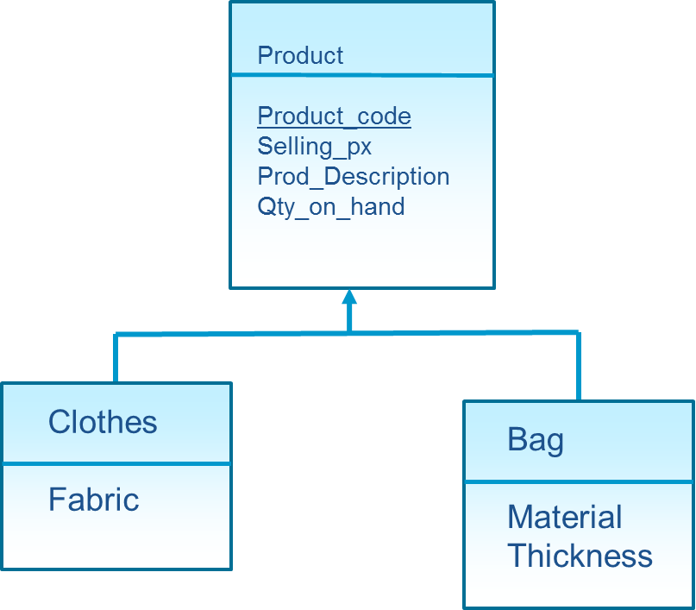
Entity Relationship Diagram - Generalization Hierarchy
The Clothes subtype inherits attributes of Product supertype
The Bag subtype inherits attributes of Product supertype
Subtype entities inherits attributes of the supertype.
Subtype possesses subtype-specific attributes as well as those associated with supertype attributes.

Slide 70
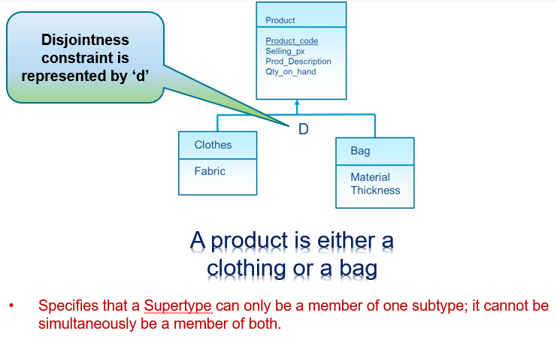
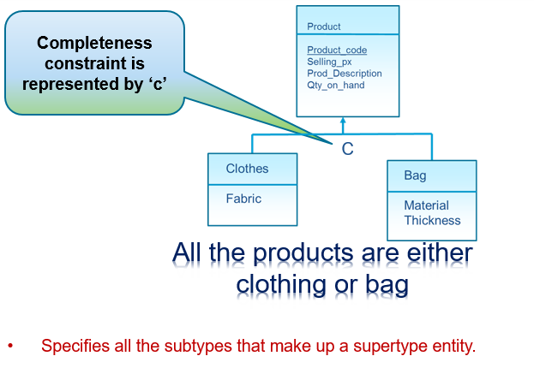
Entity Relationship Diagram - Generalization Hierarchy
Disjointness Constraint
Completeness Constraint

Slide 71
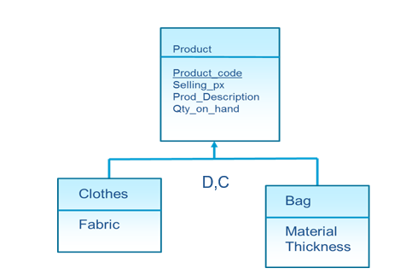
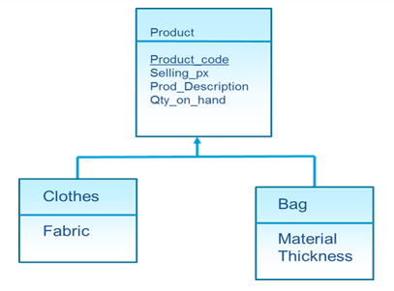
Entity Relationship Diagram - Generalization Hierarchy
The Disjointness constraint shows that the product is either a clothing or a bag. The Completeness constraint shows that there are only 2 types of products: Clothes or Bag.
The omission of Disjoint constraint implies that a product can be both an article of clothing and a bag at the same time.
The omission of the Completeness constraint implies there are other types of products besides clothes and bags eg. shoes.

Slide 72
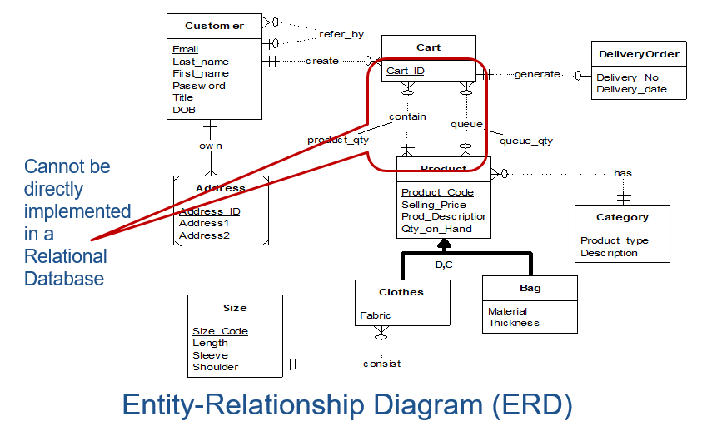
Entity Relationship Diagram – Many to Many Relationships

Slide 73
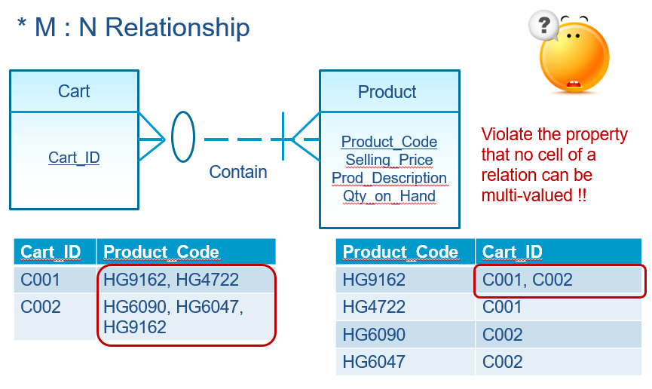
Entity Relationship Diagram – Many to Many Relationships

Slide 74
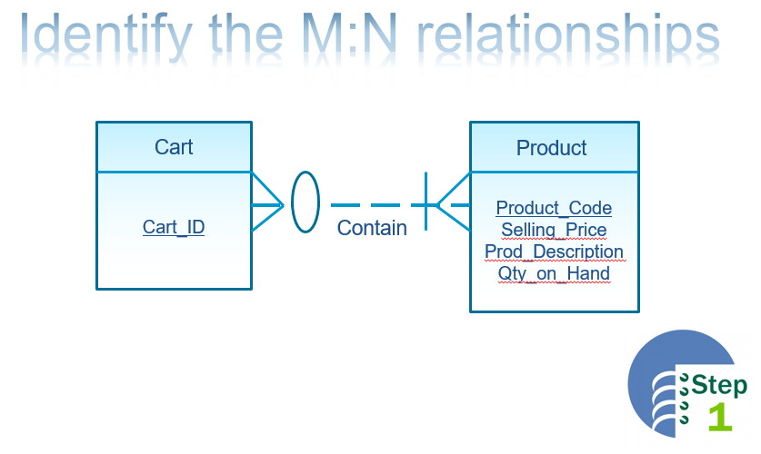
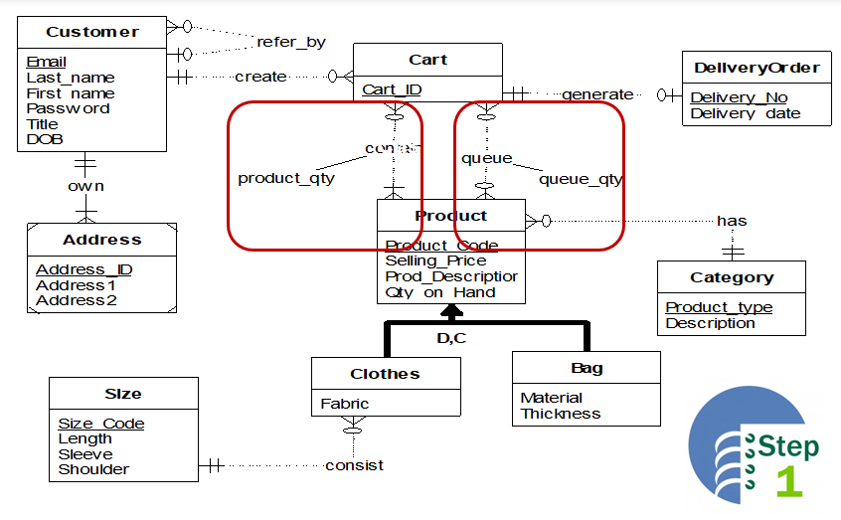
Entity Relationship Diagram – Transform to EERD

Slide 75
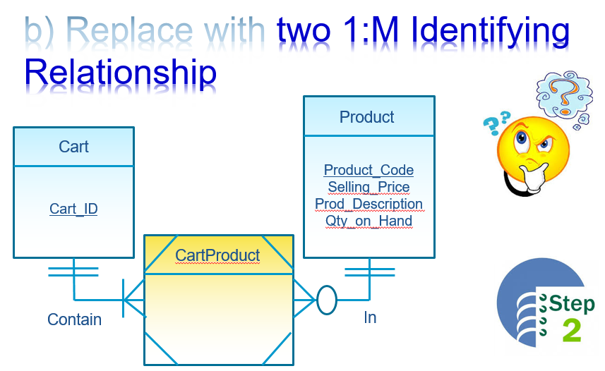
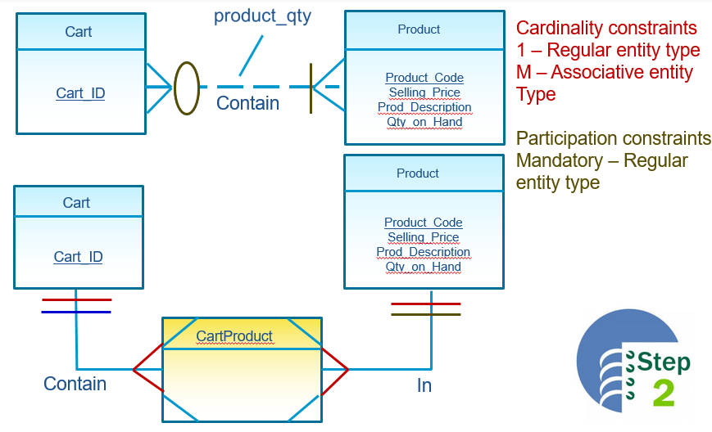
Entity Relationship Diagram – Transform to EERD

Slide 76
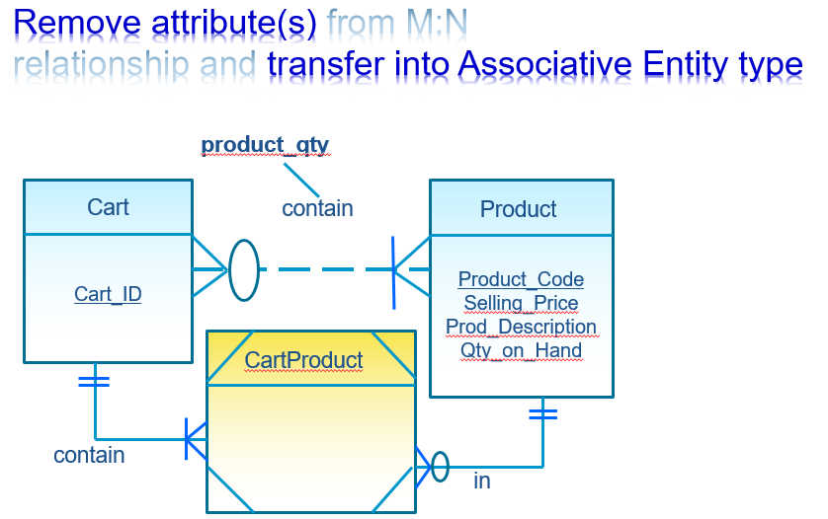
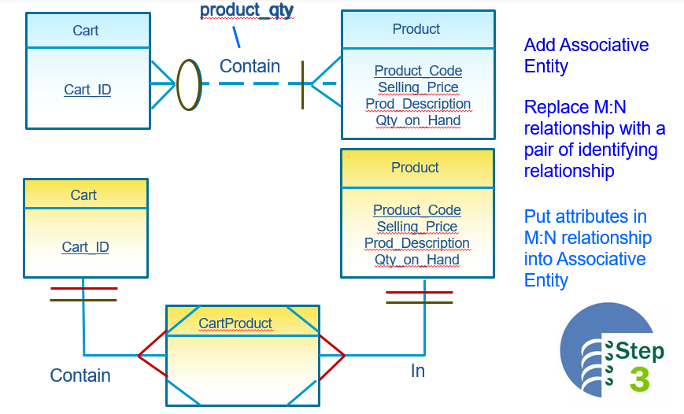
Entity Relationship Diagram – Transform to EERD

